Slide 1
A First Book of ANSI C Fourth Edition
Chapter 8
Supplement: Searching and Sorting Methods

Slide 2
Objectives
Introduction to Search Algorithms
Introduction to Sorting Algorithms

Slide 3
Linear Search
Algorithm:
set found to false; set position to –1; set index to 0
while index < number of elts. and found is false
if list[index] is equal to search value
found = true
position = index
end if
add 1 to index
end while
return position

Slide 4
Linear Search - Example
Array numlist contains:
Searching for the the value 11, linear search examines 17, 23, 5, and 11
Searching for the the value 7, linear search examines 17, 23, 5, 11, 2, 29, and 3
17 | 23 | 5 | 11 | 2 | 29 | 3

Slide 5
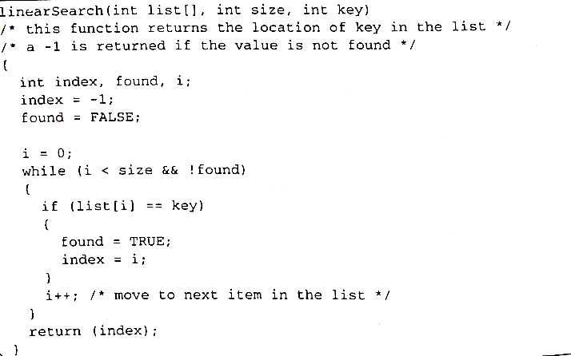
The function linearSearch ()

Slide 6
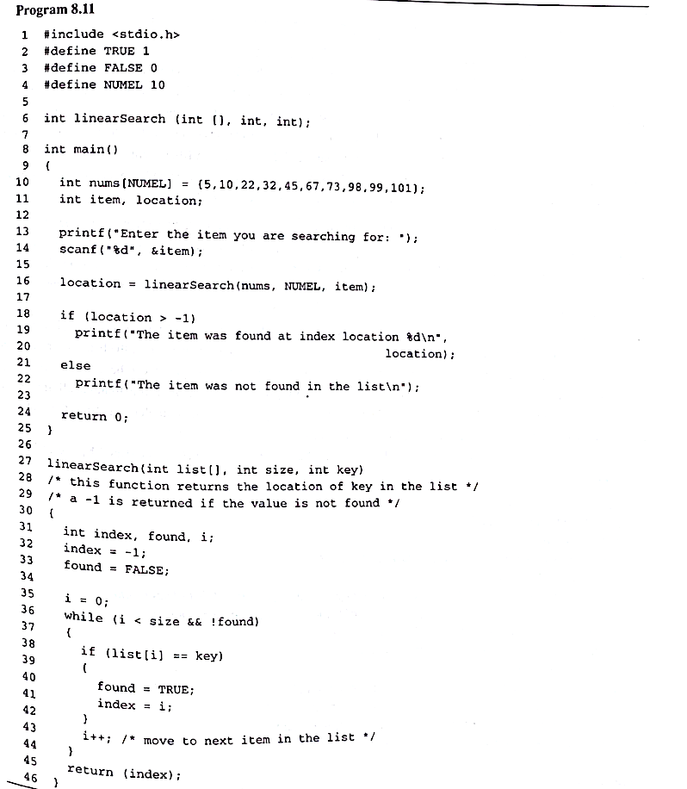
Program 8.11

Slide 7
Linear Search - Tradeoffs
Benefits:
Easy algorithm to understand
Array can be in any order
Disadvantages:
Inefficient (slow): for array of N elements, examines N/2 elements on average for value in array, N elements for value not in array

Slide 8
Binary Search
Requires array elements to be in order
Divides the array into three sections:
middle element
elements on one side of the middle element
elements on the other side of the middle element
If the middle element is the correct value, done. Otherwise, go to step 1. using only the half of the array that may contain the correct value.
Continue steps 1. and 2. until either the value is found or there are no more elements to examine

Slide 9
Binary Search - Example
Array numlist2 contains:
Searching for the the value 11, binary search examines 11 and stops
Searching for the the value 7, linear search examines 11, 3, 5, and stops
2 | 3 | 5 | 11 | 17 | 23 | 29

Slide 10
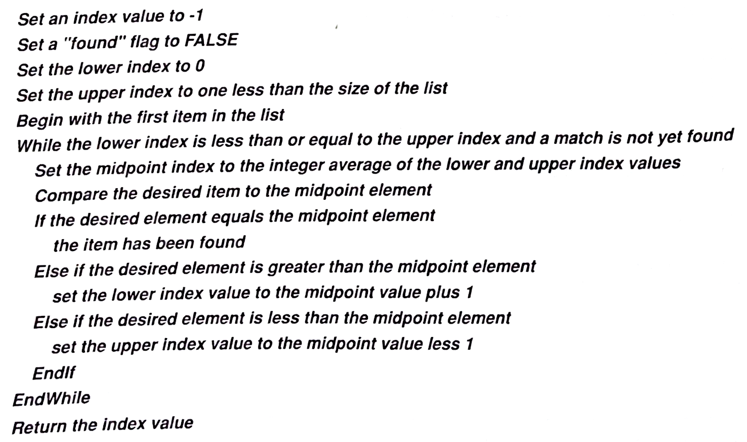
The Binary Search Algorithm

Slide 11
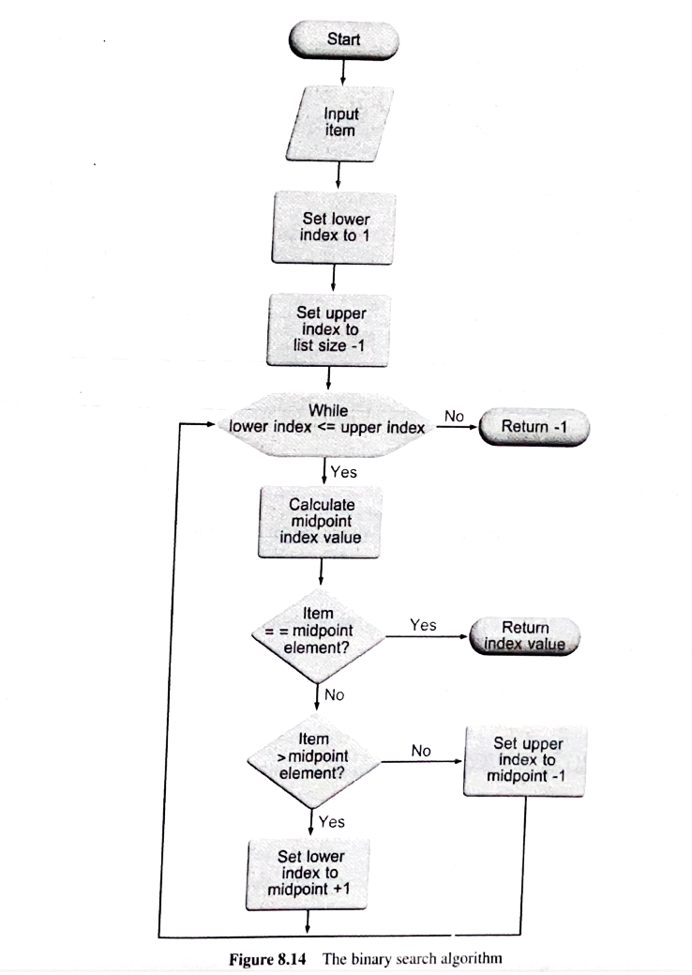
The Binary Search Algorithm (continued)

Slide 12
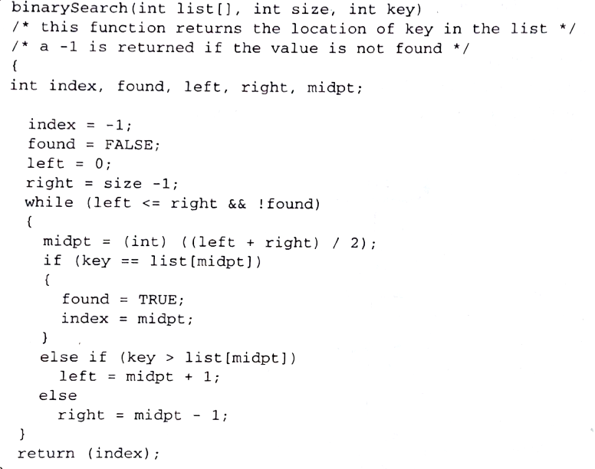
binarySearch() function

Slide 13
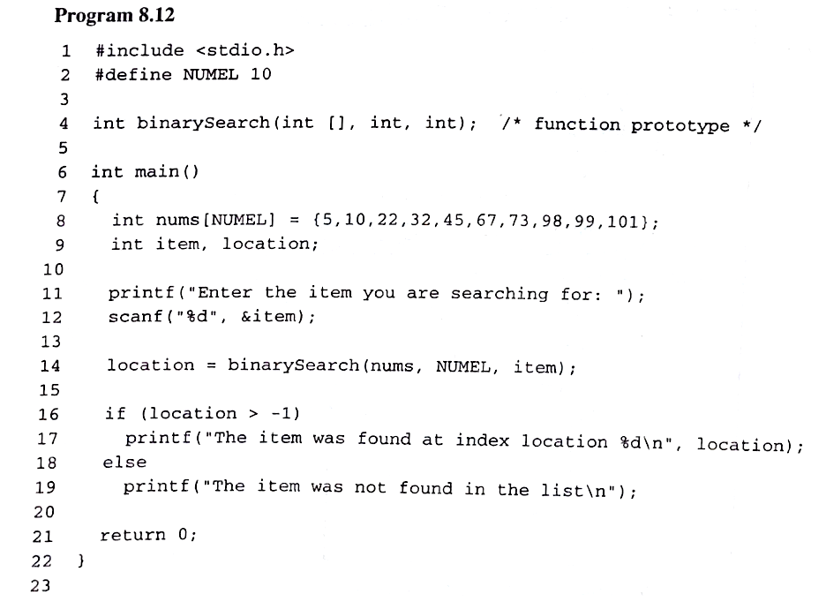
Program 8.12

Slide 14
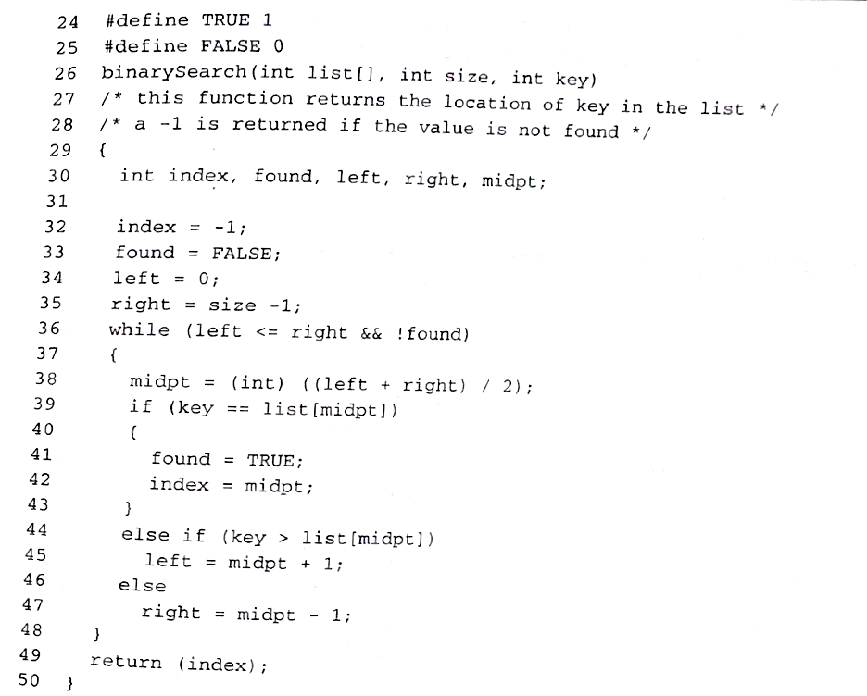
Program 8.12 (continued)

Slide 15
Binary Search - Tradeoffs
Benefits:
Much more efficient than linear search. For array of N elements, performs at most log₂N comparisons
Disadvantages:
Requires that array elements be sorted

Slide 16
Introduction to Sorting Algorithms
Sort: arrange values into an order, ascending or descending
Two major categories of sorting:
Internal sort
the data list is not too large and the complete list can be stored within the computer's memory
Selection sort, Bubble sort
External sort
much larger data sets that are stored in large external disk or tape files, and cannot be accommodated within the computer's memory as a complete unit
Quicksort

Slide 17
Selection Sort
Concept for sort in ascending order:
Locate smallest element in array. Exchange it with element in position 0
Locate next smallest element in array. Exchange it with element in position 1.
Continue until all elements are arranged in order

Slide 18
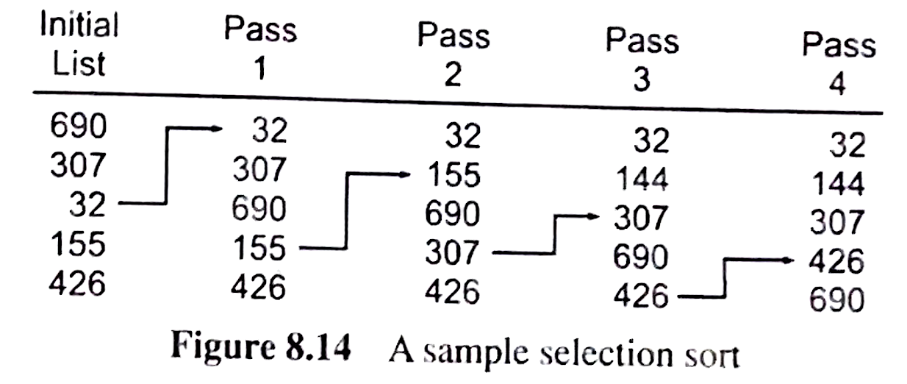
Example

Slide 19
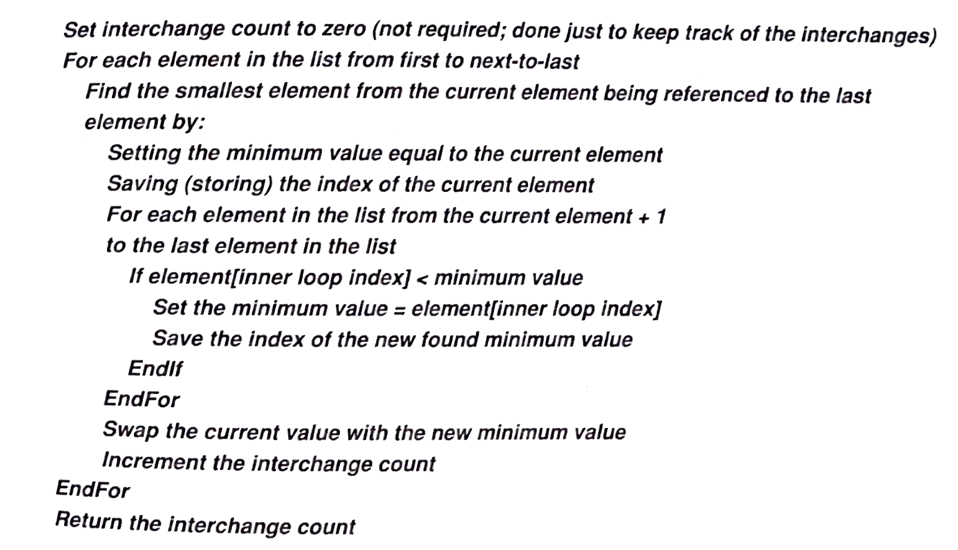
Selection Sort Pseudocode

Slide 20
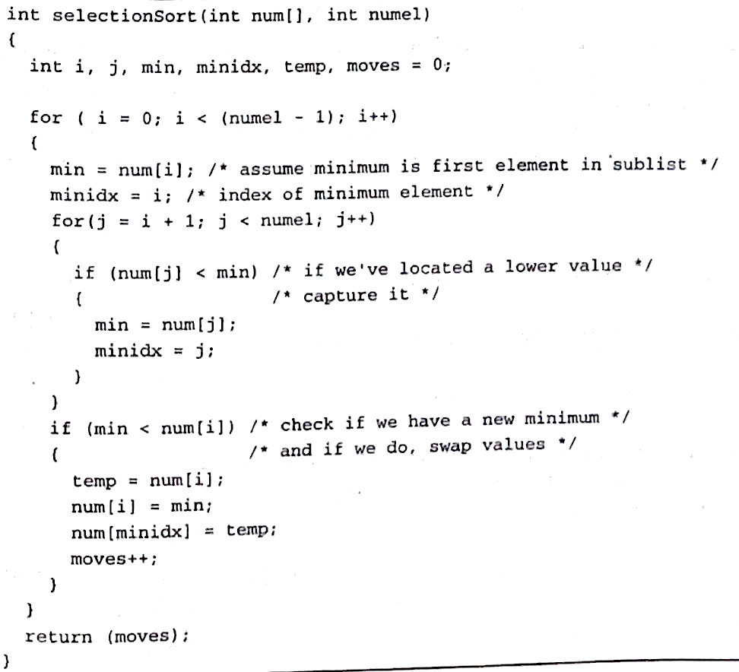
selectionSort() function

Slide 21
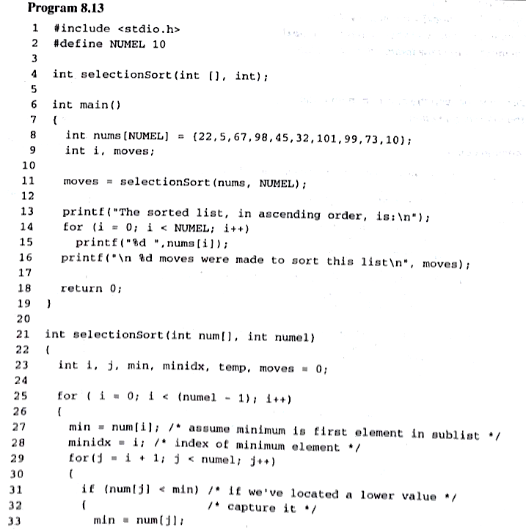
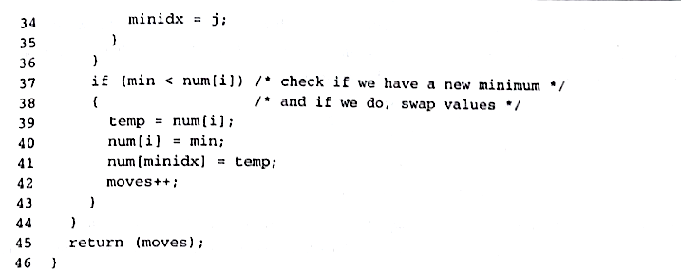
Program 8.13

Slide 22
Selection Sort - Tradeoffs
Benefit:
More efficient than Bubble Sort, since fewer exchanges
Disadvantage:
May not be as easy as Bubble Sort to understand

Slide 23
Bubble Sort
Concept:
Compare 1st two elements
If out of order, exchange them to put in order
Move down one element, compare 2nd and 3rd elements, exchange if necessary. Continue until end of array.
Pass through array again, exchanging as necessary
Repeat until pass made with no exchanges

Slide 24
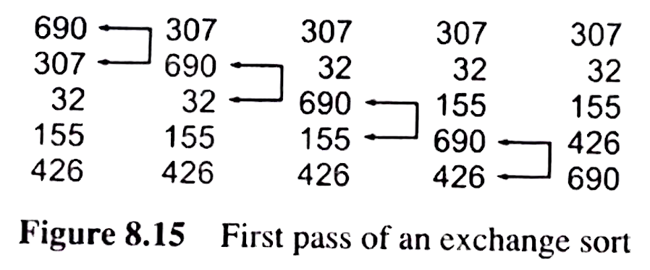
Example

Slide 25
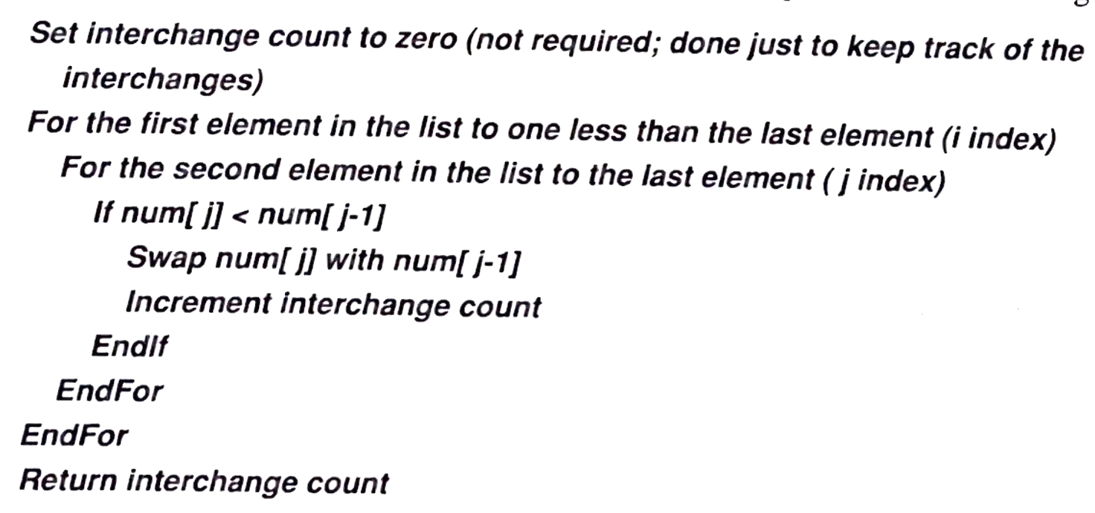
Bubble Sort Pseudocode

Slide 26
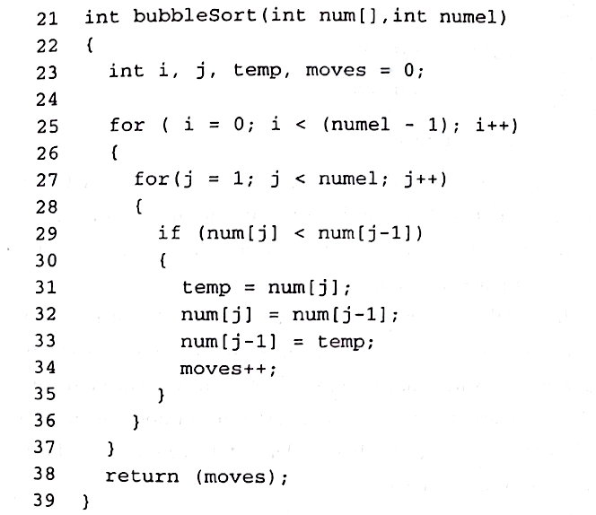
bubbleSort() function

Slide 27
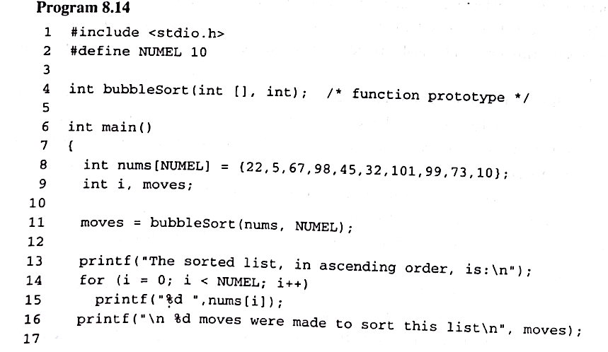
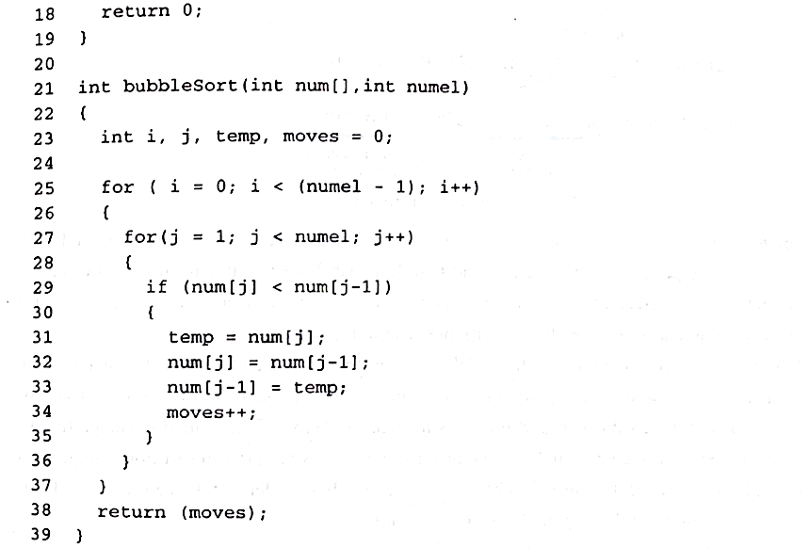
Program 8.14

Slide 28
Bubble Sort - Tradeoffs
Benefit:
Easy to understand and implement
Disadvantage:
Inefficient: slow for large arrays

Slide 29
Quick Sort
The Quicksort
also called a “partition” sort, divides a list into two smaller sublists and sorts each sublist by portioning into smaller sublists, and so on.
The order of a Quicksort is Nlog₂N.
Thus, for a 1000 list, the total number of comparisons for a Quicksort is in the order of 10,000 compared to 1,000,000 for a selection or exchange sort.

Slide 30
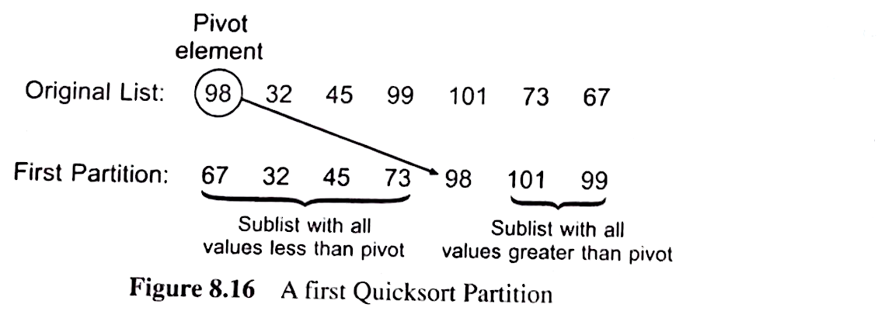
Partitioning process
The Quicksort puts a list into sorted order by a partitioning process.
At each stage the list is partitioned into sublists so that a selected element, called the pivot, is placed in its correct position in the final sorted list.

Slide 31
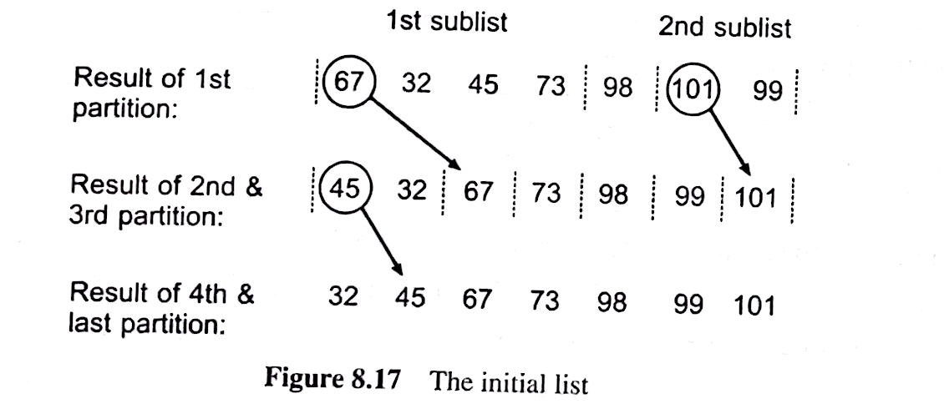
Partitioning process (continued)

Slide 32
Partitioning process (continued)
First saving the value of the pivot, which frees its slot to be used by another element.
The list is then examined from the right, starting with the last element in the list, for a value less than the pivot; when one is found, it is copied to the pivot slot. This copy frees a slot at the right of the list for use by another element.
The list is now examined from the left for my value greater than the pivot; when one is found it is copied to the last freed slot.
This right-to-left and left-to-right scan is continued until the right and left index values meet.
The saved pivot element is then copied into this slot. At that point all values to the left of the index are smaller than the pivot value and all values to the right are greater.

Slide 33
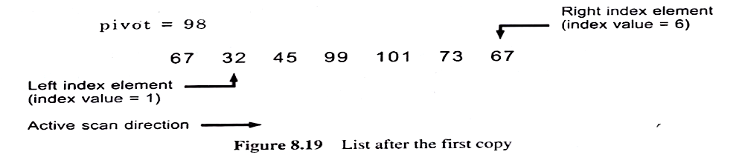
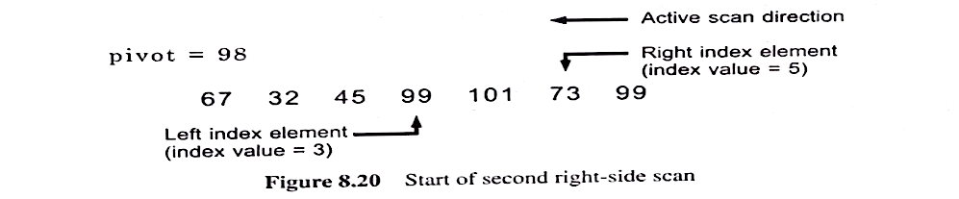
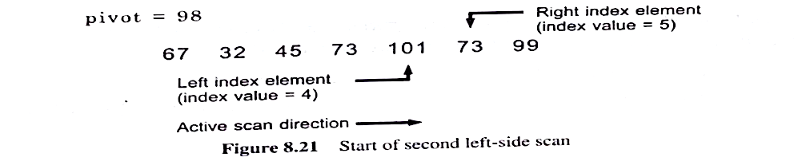

Partitioning process (continued)

Slide 34
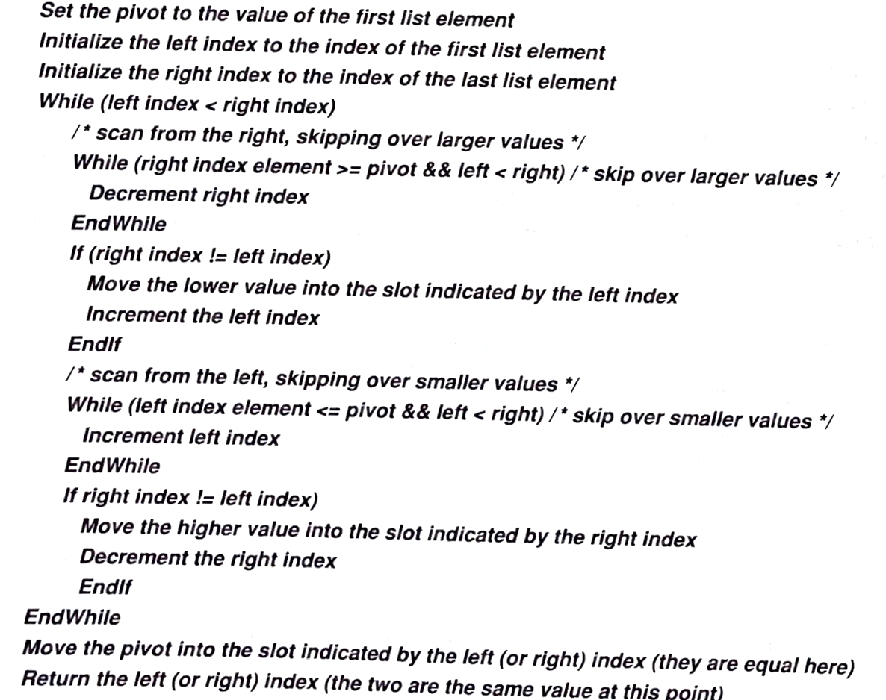
Partition Pseudocode

Slide 35
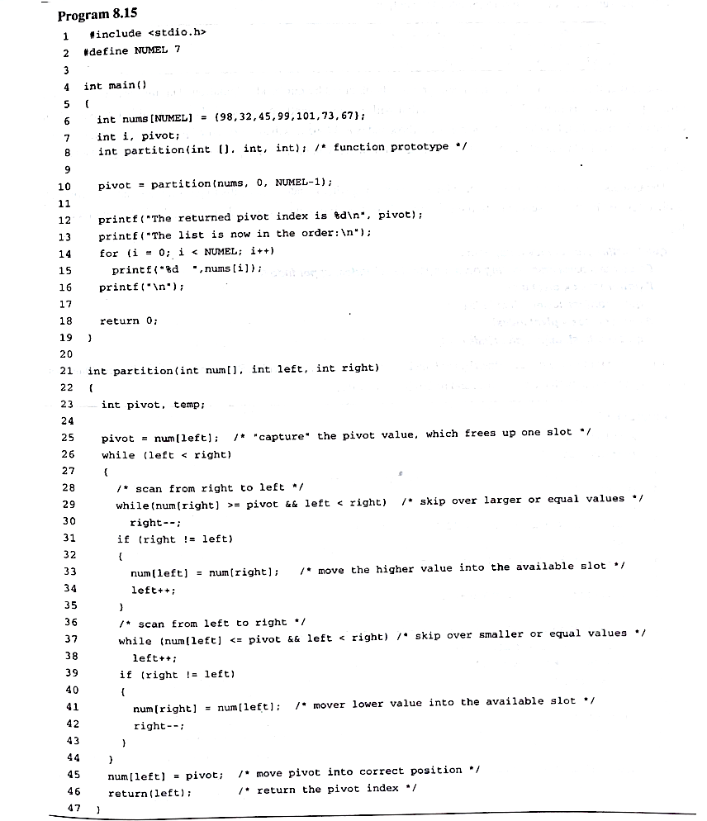
Program 8.15 (partition)

Slide 36
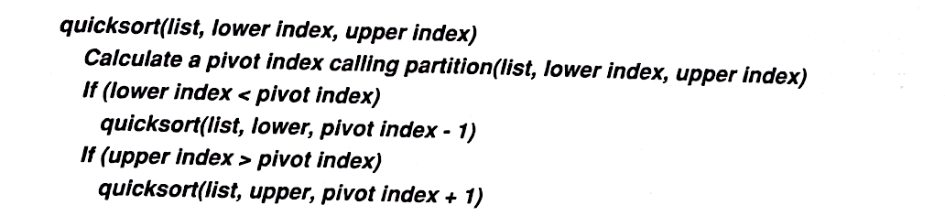
quicksort() recursive
function
void quicksort(int num[], int lower, int upper)
{
int pivot;
int partition(int[], int, int);
pivot = partition(num, lower, upper);
if (lower < pivot)
quicksort(num, lower, pivot - 1);
if (upper > pivot)
quicksort(num, pivot + 1. upper);
return;
}

Slide 37
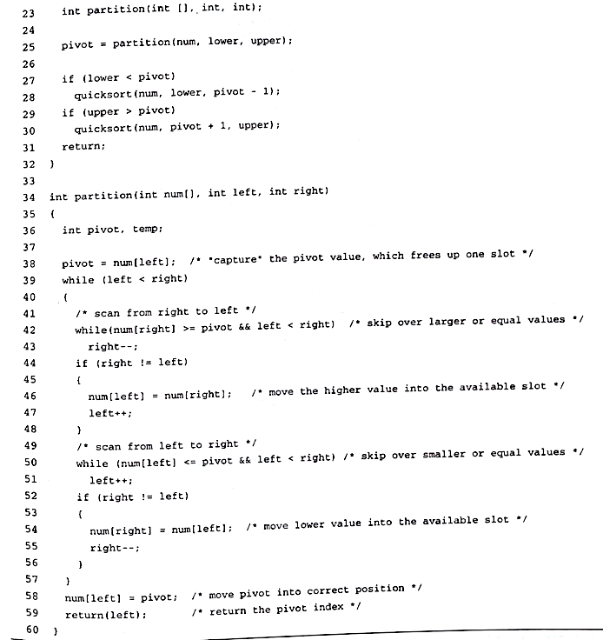
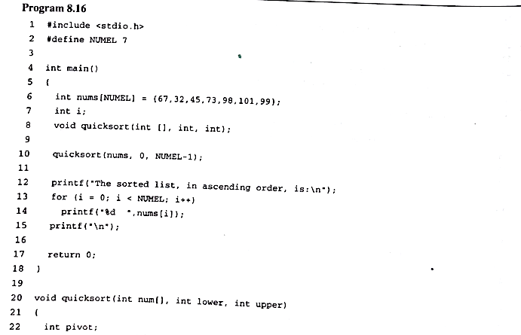
Program 8.16

Slide 38
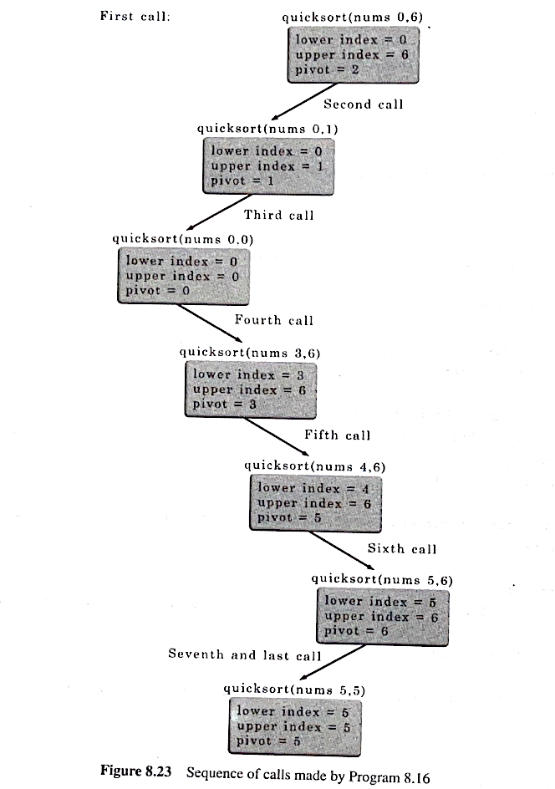
Sequences of calls

